Slide 1
Digital Security and Forensics AICT006-4-2-DSF Version 1
Introduction to Cryptography

Slide 2
Topic & Structure of The Lesson
Introduction to Cryptography
Cryptographic Techniques
Symmetric
Asymmetric
Hash function

Slide 3
Learning Outcomes
At the end of this topic, you should be able to
Differentiate three main cryptographic techniques

Slide 4
Key Terms You Must Be Able To Use
If you have mastered this topic, you should be able to use the following terms correctly in your assignments and exams:
Cryptography
Symmetric vs asymmetric encryption
Hashing

Slide 5
Secure Systems
1. Security policy
What needs to be protected
Kinds / level of protection
Responsibilities
Auditing policy
2. Security environment
Physical environment
Physical security
Hardware, operating system
Firewalls, etc.
3. Security mechanisms
Cryptography
Authentication
Security protocols
4. Monitoring and auditing procedures
Monitor access
Audit trails
Feedback on failures, security breaches
Containment & recovery

Slide 6
Encryption, Cryptography
The Internet is a public access network
Messages can be intercepted and read by anyone
Messages can be modified in transit
Message senders can be impersonated
Encryption is a mechanism that can be incorporated into security protocols

Slide 7
Encryption
The conversion of data into a form, called a ciphertext, which cannot be easily understood by unauthorised entities.
Encryption can be anything from a simple process of substituting one character for another, in which case the key is the substitution rule, to some complex mathematical algorithm.

Slide 8
Decryption
The process of converting encrypted data back into its original form, so it can be understood.

Slide 9
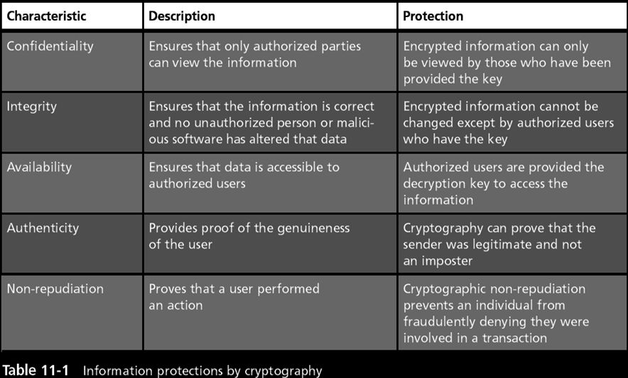
Encryption and Security

Slide 10
Cryptographic Techniques
Encryption: Scrambling a message
Algorithm: Method used for scrambling
Key: the output of certain encryption algorithms is controlled by a value called an encryption key
More formally: The algorithm is used to transform plaintext into ciphertext

Slide 11
Cryptographic Techniques
Classes of algorithms:
Reversible, symmetric (Conventional)
Reversible, asymmetric (Public Key)
One-Way (Hash)
Properties of algorithms:
Reversible: can transform ciphertext back to plaintext
Symmetric: uses one key for both encryption and decryption
Asymmetric: uses different keys for encryption / decryption

Slide 12
Symmetric Key
Symmetric key cryptography, also called private or secret key cryptography
The same key is used to encrypt and decrypt the data.
Plaintext
Plaintext
Encrypt with
secret key
Decrypt with
secret key
Internet
Ciphertext

Slide 13
Encryption and Security

Slide 14
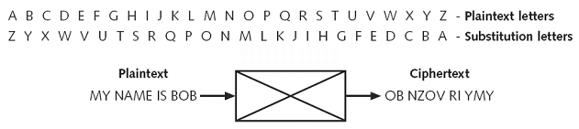
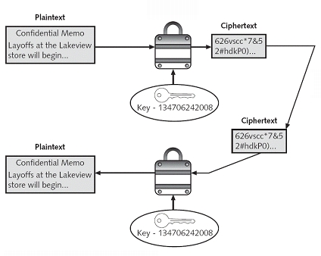
Symmetric, Reversible (Shared Key)
Need to know the
substitution alphabet
and the number of
iterations to decrypt
Need to know the algorithm and the secret key to decrypt
Notes:
14

Slide 15
Symmetric, Reversible (Shared Key)
ADFG(V)X
Alberti
AMSCO
Autokey
Beaufort
Bifid
Caesar / Rot-13
Enigma
Four-Square
Freemason
Gronsfeld
Hill
Kamasutra
Larrabee
Homophonic
Multiplicative
Navajo
Nihilist
Playfair
Pollux
Polybius
Porta
Rotation
Scytale
Templar
Transposition
Transposition
Trithemius
Vigenère
Zigzag (Rail Fence)
Classic Symmetric Cyphers
Invented for use by People
http://www.cryptool-online.org/index.php?option=com_content&view=article&id=47&Itemid=29&lang=en

Slide 16
Asymmetric, Reversible (Public Key)
Uses a key pair (a,b)
What one key does, the other can undo
Either key can be used to encrypt a message - the other key is then used to decrypt it
The message cannot be decoded with the key that encoded it
The message can only be decoded by a matching key
Knowledge of one key does not allow the other to be deduced
Public key
Private key
One key can be published while the other is kept secret and secure

Slide 17
Encryption and Security

Slide 18
Asymmetric, Reversible (Public Key)
Private Message / Secret
All devices can use a station’s public key to encrypt data to send to the station.
The receiving station decrypts the data using its own private key.
Assured Message
Sender uses private key to encrypt data
The receiving station decrypts the data using the sender’s public key.
If the private key is kept secure, cannot deny sending the message (non-repudiation)

Slide 19
Public Key Encryption
Public key – the key is publicly known
Private key – secret key
Public key
Message
Encrypt
ρφωεκφσ
Private key
Message
Decrypt
ρφωεκφσ

Slide 20
Symmetric vs Asymmetric Key
Symmetric key
Asymmetric key
Typically both share
same key
Two separate keys: a public and a private key
Typically faster x100!
Typically slower
Examples:
DES, IDEA, RC5, AES, …
Examples:
RSA, ElGamal Encryption, ECC…
We will talk a lot more about this next week …

Slide 21
One-Way Algorithms (Hash functions)
Create a message digest or “fingerprint”
Plaintext message can not be deduced from its hash
Size of the digest is always the same, regardless of the size of the message
Algorithm is designed so that a small change in the plaintext produces a big change in the message digest.
Plaintext is run through the algorithm and compared to a trusted, stored copy
Used for passwords by operating systems, HTTP basic authentication

Slide 22
Encryption and Security

Slide 23
/etc/shadow
When the system administrator sets up an account, the password is typed in for the first time. The system stores the encrypted password in a secure database.
User : Password : UID : GID : GCOS : Home : Shell
root:KnR8gQb3hDYg6:0:0:root:/root:/bin/bash
httpd:zYFuFaKw6ZovI:15:60:Apache_1.2.4:/home/httpd:/bin/bash
tomas:k6x5IqJcB1C.Q:500:500:TommyGun:/home/tomas:/bin/bash
guest:qfRc424I3/QGI:502:502:Guest User:/home/guest:/bin/pdmsh
jacob:dbBOzTSdCX5HU:503:503:Linux User:/home/jacob:/bin/bash
peterlai:T5RlEJUib7wOk:504:504:Linux User:/home/peterlai:/bin/bash
toshiba:DPz8cCRkIQc1Q:505:502:SLIP User:/home/rest:/usr/sbin/dip -i
victor:wiSml8WiVwJt2:506:506:Linux User:/home/victor:/bin/bash
dolphin:5JaZ7KmR7hEzM:508:507:Mail User:/home/dolphin:/usr/bin/pine
Each time the user logs in after that, the system encrypts the password that has been typed in and compares it to the cyphertext stored in the database.

Slide 24
How secure is Encryption?
Function of the algorithm
Should be such that even if opponent knows the algorithm and has the ciphertext, he is unable to decrypt or to determine the key used
Function of the length of the key
Generally, the longer the key, the harder to break the message by trying all the possibilities:
“Brute Force Attack”
A binary key of 4 bits has 2⁴ =16 possibilities, while a 56 bit key has 2⁵⁶ ≈ 72 quadrillion possibilities

Slide 25
Randomness
The important feature of most cryptographic operations is that they are easy to perform if you have the right information and infeasible to perform if you don’t have that information.
Randomness means unguessable input. If the input is guessable, then the output can be easily calculated.
Suppose we play several rounds of a game with the same deck of cards.
The shuffling of the deck between rounds is the primary source of randomness.
If we didn't shuffle properly, you could beat the game by predicting cards.

Slide 26
Randomness
For security through encryption, predictability is BAD.
If an attacker can predict the key's value or even narrow down the number of keys that must be tried, the protocol can be broken with much less effort than if truly random keys had been used.
It is vital that secrets be generated using an unpredictable random-number source.

Slide 27
Randomness
Suppose that an adversary observes a ciphertext output of a public-key algorithm, and has an idea what the plaintext might be
The adversary can simply try encrypting each of his guesses under the recipient’s public key, and compare each result to the target ciphertext
To combat this attack, public key encryption schemes must incorporate an element of randomness, ensuring that each plaintext maps into one of a large number of possible ciphertexts
Good hash algorithms also produce different outputs for the same plaintext

Slide 28
Randomness
For symmetric encryption, if you don’t have the key you must embark an exhaustive search of the key space, or a more efficient cryptanalysis of the cipher which will require a large number of samples.
However, if you have any information on likely values of the key, your search of the keyspace is much easier (or the number of samples you need for your cryptanalysis is much lower).

Slide 29
Brute Force
Trying out all possible values is a technique called Brute Force
It is (currently) infeasible to perform 2^128 trial decryptions to discover what a 128-bit key actually is.
But if you know the key actually came from a time value that you know within a billion ticks, then your search becomes 340282366920938463463374607431 times easier!
thanks to Liudvikas Bukys for doing the math
http://stackoverflow.com/questions/499418/why-do-you-need-lots-of-randomness-for-effective-encryption

Slide 30
Passwords Cracking
Key strings
Medaboss, finalcountdown, mypassword
Dictionary
A, abilities, ability, able … yourselves, zero, zip, zoo
There are some “password recovery” utilities in the FieldKit
Your antivirus will scream and wave red flags

Slide 31
Quick Review Question
Explain how cryptography is used as security mechanisms.

Slide 32
Summary of Main Teaching Points
Introduction to Cryptography
Cryptographic Techniques
Symmetric
Asymmetric
Hash function

Slide 33

Q & A

